Slide 1
Ethical Issues in Marketing
Comparative Advertising and “Switch and Bait”

Slide 2
Deceptive Advertising
Some advertisements do not provide truthful information that misleads the customers.
Therefore, the advertisers misrepresent themselves and it involves using ambiguous statements that are not supported empirically (Ingram, 2018).
Consequently, the adverts have adverse effects on the culture and moral values of the society.
For instance, incorporating nudity and obscenities to attract the attention of potential customers portray a bad example of the advertising company.
Also, the adverts have misleading appeals to vices such as sex and substance abuse.
The repetitive misleading adverts can cause behavioral changes since individuals align their actions with the specifications of the advertising content

Slide 3
Deceptive Comparative Advertising
Deception in comparative advertising result from one company using false information to compare its products with the products of the competitor.
When making comparison, the company can misrepresent measurable characteristics such as price of alternative brands.
In this regard, the company is trying to attract customers at the expense of the competitors.
From an ethical standpoint, the company aligning its operations to the advertising code of conduct since it is spreading lies against other brands.
For example, comparative advertising between McDonalds and Burger King sparked ethical issues since Big Mac was depicted as small physically compared to Whooper (Berger Singerman LLP, 2019).

Slide 4
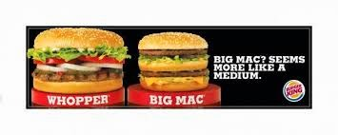
Cont.

Slide 5
Advertising Harmful Products
Harmful products include cigarettes and alcohol.
The adverts particularly glorify these products without putting into account their effects on the health statuses of the users.
Besides, they do not provide information on the doctors’ warnings about the product.
They are not ethical since the ads are aimed at improving the sales and the profits margins of the advertising firms at the expense of deteriorating health of the consumers.
For example, the Joe Camel advertisement secretly targeted kids and wanted to entice young persons to start smoking (mcoogan, n. d).
The advert presented ethical issues since it was not sensitive to the well-being of the young persons.

Slide 6
“Switch and Bait” Advertisement of Harmful Products
The advertiser provide misleading information that inaccurately capture the prices and the availability of the products.
For example, the advertisers advertise harmful products such as cigarettes without intending to make a sale or sell them at higher prices (Petryni, 2018).
Due to the addictive nature of cigarettes, the customers are exploited.
The businesses unethically lure the customers to make a purchase that turns out be a scam.
The advertisers are acting unscrupulously when they use price baits to entice potential customers to buy harmful products.

Slide 7
Cont.
In most occasions, the customers are often told that the products that they requested for are the last ones in stock (Mellinger, 2018).
The customers are told to make purchases as quickly as possible or else they will be left out.
The customers are told that they did not make it on time for a purchase and it has just been sold.
The following remarks from the salesman give the customers glimpses of hope since they lucky there is one item left in the stores.
They come back wearing a smile on their faces making you feel the customers feel excited to acquire the products even at a high price.

Slide 8
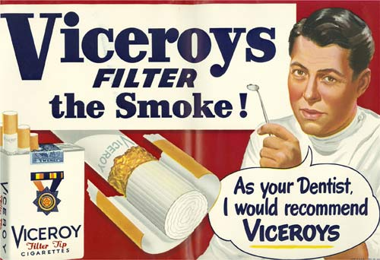
Cont.

Slide 9
References
Berger Singerman LLP. (2019). Is your competitor
making false comparative advertising
claims. Lexology. Retrieved from
https://www.lexology.com/library/detail.aspx ?g=2673c791- 04fa-436e-a734- 447ad1d4c718
Coogan. (n. d). Advertising harmful products.
Retrieved from
https://m1coogan.wordpress.com/2011/10/10/advertising- harmful-products/
Ingram, D. (2018). List of ethical and legal issues
when advertising. Chron. Retrieved from
https://smallbusiness.chron.com/list- ethical-legal-issues- advertising- 11466.html
Mellinger, B. (2018). Examples of bait and switch advertising. Chron. Retrieved from
https://smallbusiness.chron.com/examples-bait-switch-advertising-10575.html
Petryni, M. (2019). Types of deceptive advertisement. Chron.
Retrieved from
https://smallbusiness.chron.com/types-deceptive-advertisement-22945.html

